Slide 1
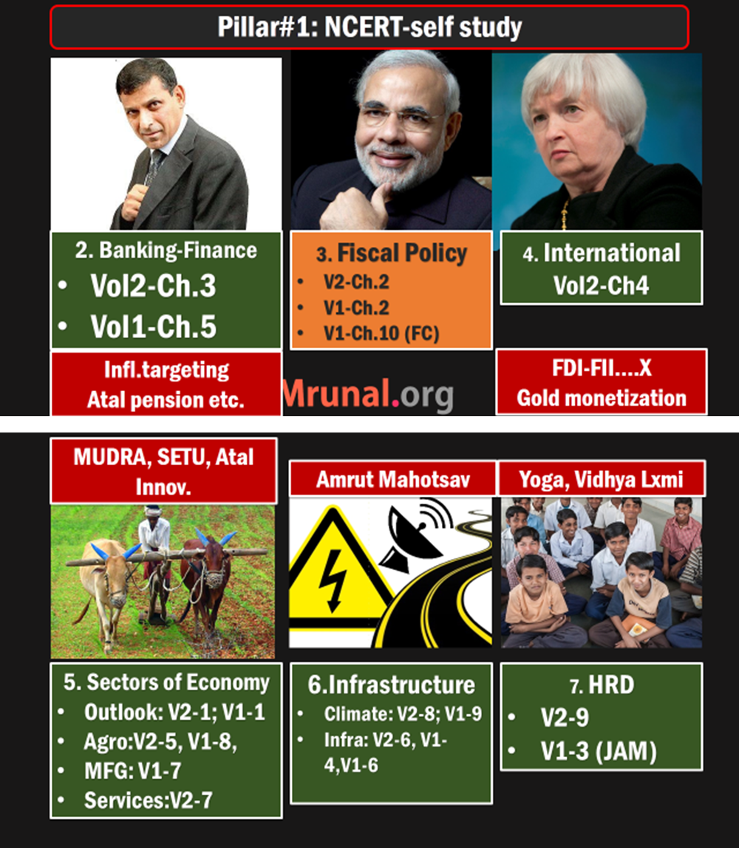
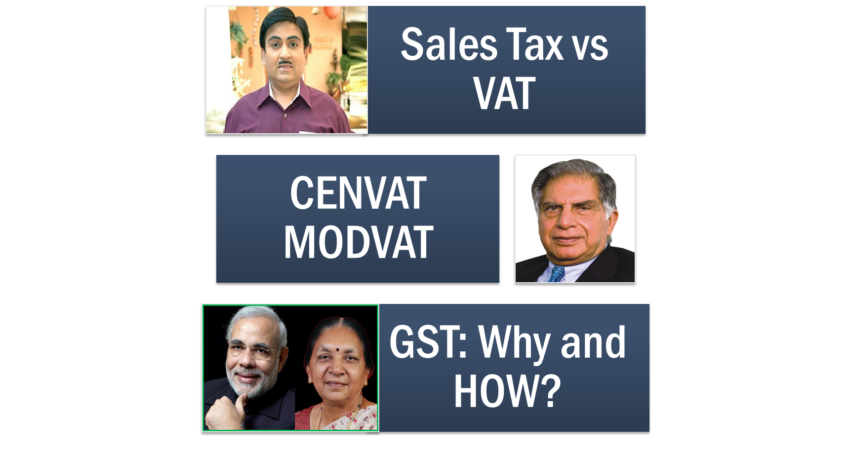



Slide 2
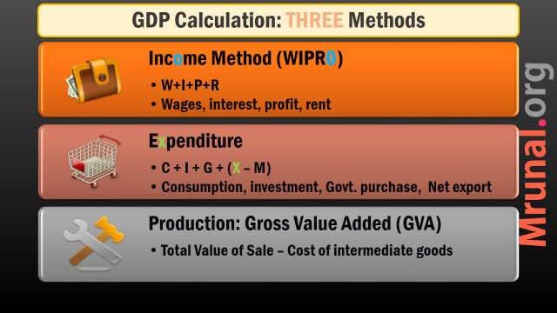
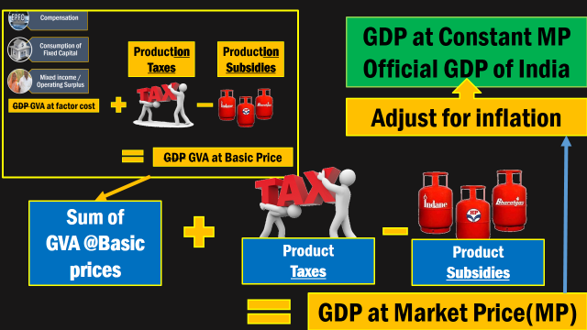

Slide 3
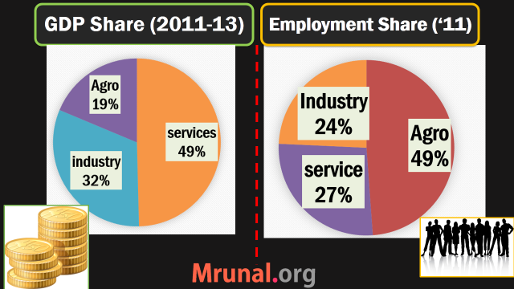
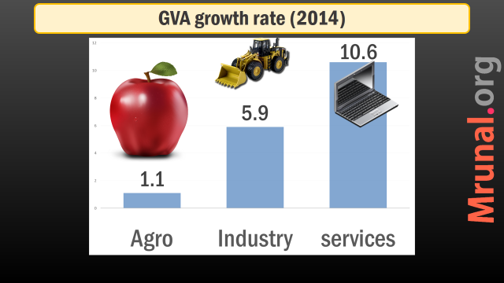

Slide 4
Moving on: Sector of Economy
Agro
Mfg+ Services
ISSUES
Survey Reforms
Issues
Survey Reforms
Budget-2015
Budget-2015

Slide 5


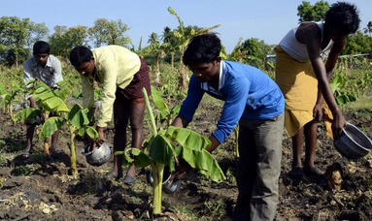
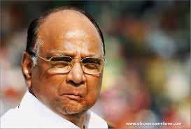
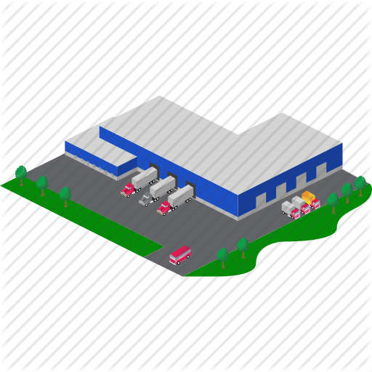
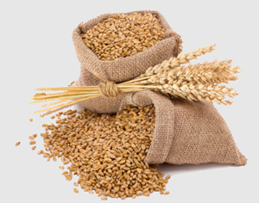

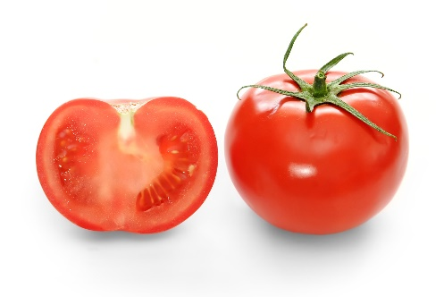
Farm Labor shortage=> Wage ▲
▲ Rural wages,
Purchasing power inflation
MSP▲ to cover losses + Ferti. subsidy
FCI open ended procurement
Rotten grain
NFSA
to unload stock
No MSP,
Storage issues
APMC Cartels

Slide 6
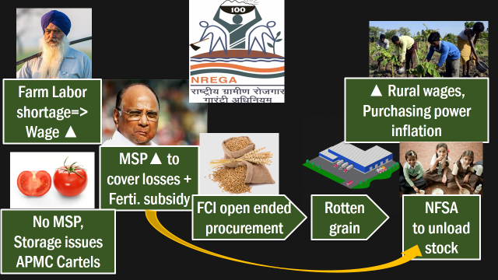
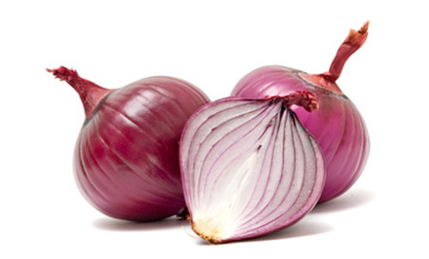
▲ MEP to ▼inflation
Genuine exporters suffer

Slide 7

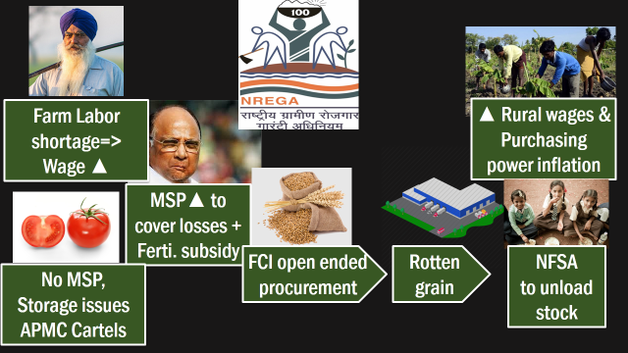

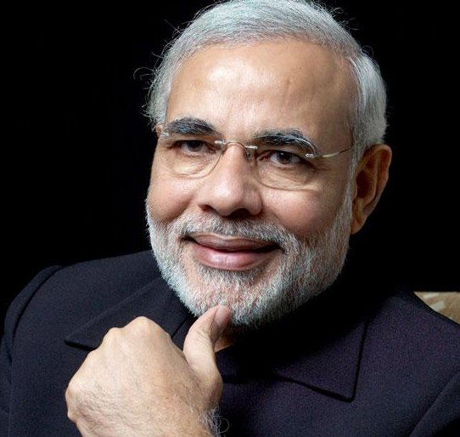
Land consolidation
Mechanization
Backward Dist. Only
Skill India
Make in India
APMC reform
Common market
MEP ▼
FDI MultiBrand?
Open Market Sale
+Shanta Kumar

Slide 8
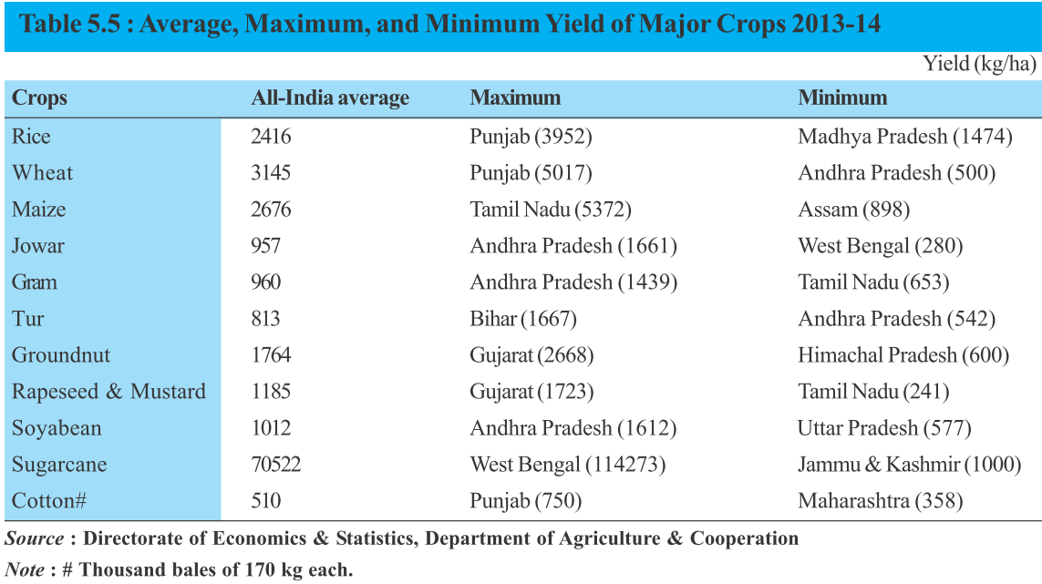
Must ▲ food production but can’t ▲ cropped area

Slide 9
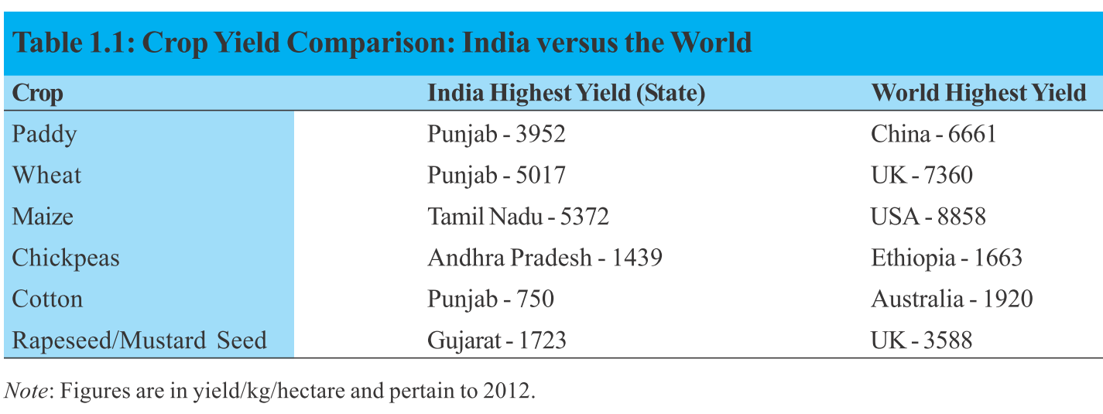
Must ▲ food production but can’t ▲ cropped area

Slide 10
Agro Yield (▲): how to?
Extension
Irrigation
Seeds
Fertilizers
Mechanization
Loans

Slide 11
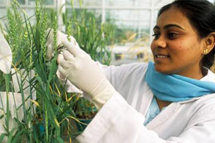
Extension
Yield improve
1 extension worker per 800-1000 farmers.
~60% farmers don’t receive technical know-how (NSSO)
They depend on other progressive farmers, marketing agents
Last mile connectivity….X
Lab to farm connectivity….X
Budget 2014: Kisan TV.

Slide 12
Extension
Yield ▲
R&D sector Suffering from ‘technology fatigue’
ICAR & other bodies: separate the roles of education, research and extension.
Invest in basic research for Indian climatic zone
Budget 2015: new horticulture inst. @Amritsar

Slide 13
Agro Yield (▲): how to?
Extension
Irrigation
Seeds
Fertilizers
Mechanization
Loans

Slide 14
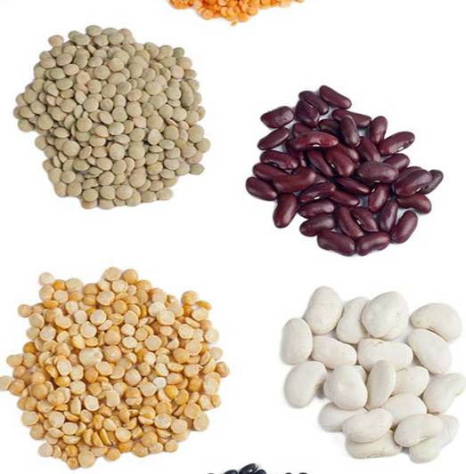
seeds
Yield ▲
20-25% of productivity relies on seed quality
Shortage of certified seeds.
BT and GM crops: Evidence of negative health effect lacking
So need to rethink regulatory framework.

Slide 15
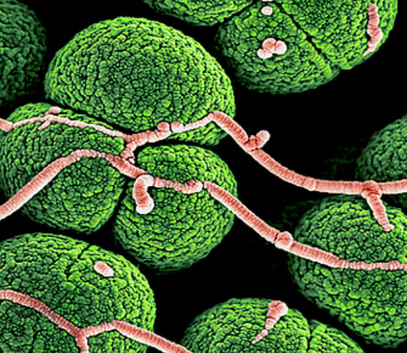
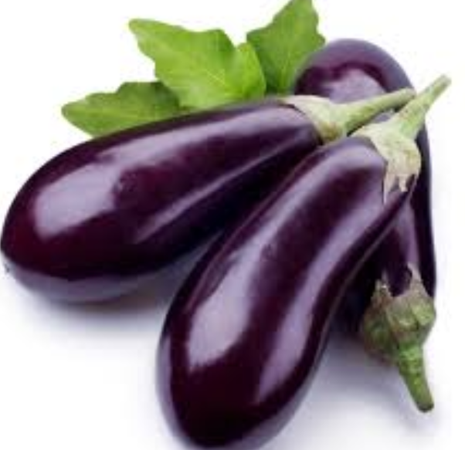

BT Brinjal
Crystal protein
Bacillus Thuringiensis
Toxic protein binds with insect guts.
Notes:
Soil Bacteria Bacillus Thuringiensis=> take out crystal protein gene from it and insert in normal brinjal=> Bt.Brinjal. If borer/pests/larvae attack they die because of toxic protein binds in their guts.

Slide 16


No to BT/GM
YES to BT/GM
Bt-Toxin harmful to human
Indigenous verities and Biodiversity loss
Banned in Europe. Strict labelling requirements.
Only rich farmers benefit
Toxin broken down in guts
Insufficient anti-evidences
Bio fortification: vitamins and nutrients increased
China doing R&D
Norman Barlaug recommends
Survey recommends

Slide 17
Agro Yield (▲): how to?
Extension
Irrigation
Seeds
Fertilizers
Mechanization
Loans

Slide 18
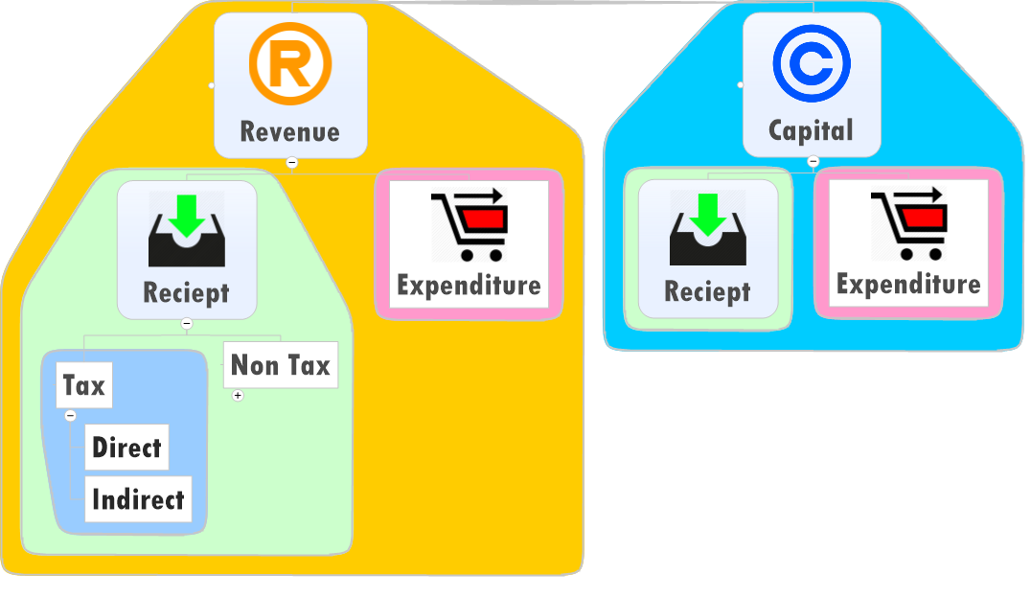
Subsidies

Slide 19

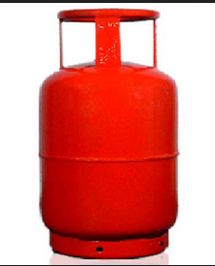


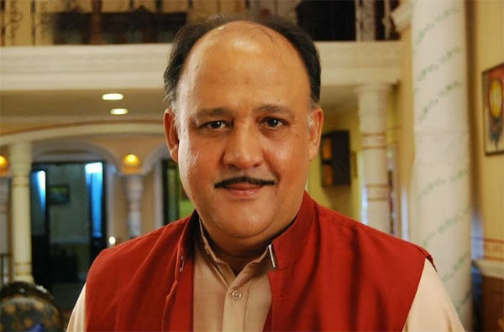

BE-2015: Revenue Expenditure
subsidies
Grants
Police
Notes:
grants

Slide 20
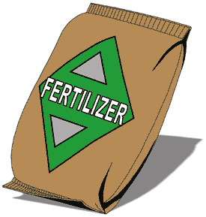
RE-2014 and BE-2015: Subsidies
Decreasing (~70k crores)
Desi Urea
Decontrolled
Imported Urea

Slide 21
Why urea over-consumption?
Subsidies
Nutrient Based subsidies (2010)
Company gets subsidy based on wt. of micro-macro nutrients
Tailor-made fertilizers as per soil requirement
But NBS subsidies not paid on time to companies
and urea kept out.
Result: farmers prefer cheap urea.

Slide 22
Soil contamination
Ratio | Ideal | real
Nitrogen (N) | 4 | 8.2
Phosphorus (P) | 2 | 3.2
Potassium (K) | 1 | 1
Notes:
Under NBS, govt. gives subsidy based on weight of the different Macro/micro nutrient in the fertilizer

Slide 23
Overuse of urea
fertilizer
Soil contamination
Eutrophication => algae bloom.
natural gas shortage => import=> higher urea subsidy.
Natural gas: methane
Methane + O2 + N2 + catalyst=> NH3 (Hyber process)
Ammonia=>Urea

Slide 24
Cheap urea
fertilizer
Smuggling to Nepal, Bangladesh
Smuggling to dye, ink, chemical industry
Solution:
Include urea under NBS
Soil health card.

Slide 25

Soil Health Card scheme
fertilizer
"Swasth Dharaa. Khet Haraa." - Healthy Earth. Green Farm.
Card to display soil fertility
recommend fertilizers according to soil and crop requirement
14 crore cards in next 3 years
100 Mobile testing labs.

Slide 26
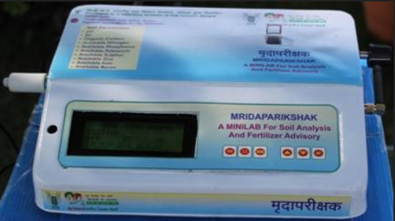
Mridaparikshak
digital-mobile-soil-test kit.
ICAR's Bhopal centre
11-12 pass can use.
Tests soil parameters- PH, NPK, micronutrients like zinc, boron and iron.
farmers get SMS

Slide 27
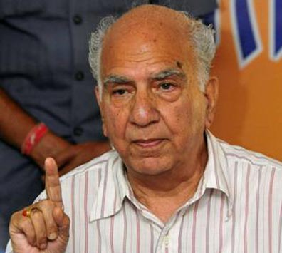
Shanta Kumar
Fertilizer
Farmer DBT: Rs. 7000 / ha to buy fertilizer
He uses soil health card, buy fertilizer of his choice.
Deregulate fertilizer sector- no more subsidies, no more price controls over mfg. units.

Slide 28
Agro Yield (▲): how to?
Extension
Irrigation
Seeds
Fertilizers
Mechanization
Loans

Slide 29

Farm Mechanization
Yield improve
Must for getting max. return on other inputs viz. seeds, fertilizers, irrigation.
India: 40% mechanized (growing @5%)
Developed countries: 90%
Employment to rural youth in maintenance.
MNREGA induced Labour shortage solved.

Slide 30
Farm Mechanization
Yield improve
Different soil-climatic regions
Small farms with limited income
Loan support….x (3% of total credit to farm sector)
Solution: Land reforms, land consolidation, cooperative farming.

Slide 31
Agro Yield (▲): how to?
Extension
Irrigation
Seeds
Fertilizers
Mechanization
Loans

Slide 32
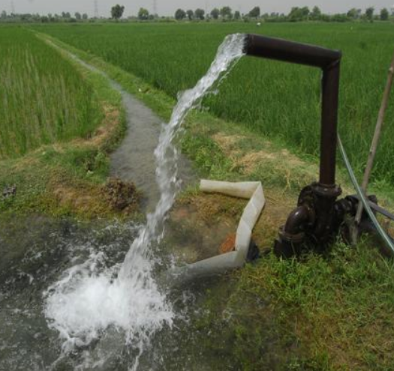
Irrigation
Yield ▲
~40% of Total arable area irrigated
90s: Accelerated Irrigation Benefit Programme (AIBP) to finish incomplete projects.
Still no improvement since 1st-FYP

Slide 33
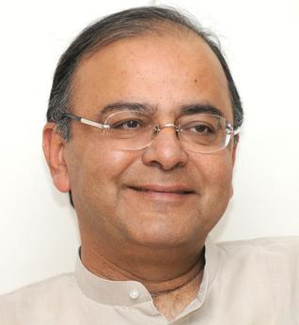
Irrigation Budget 2015
Yield ▲
Gram Sinchai Yojana: per drop, More crop
Pradhan Mantri Krishi Sinchai Yojana
Focus on micro-irrigation and watershed Development.
Paramparagat Krishi Vikas Yojana (Organic farming)
RKVY budget halved (14th FC- 42%)

Slide 34
Agro Yield (▲): how to?
Extension
Irrigation
Seeds
Fertilizers
Mechanization
Loans

Slide 35

Credit / Loan
Yield improve
To Discourage distress sale & suicide
To Buy better inputs for next cropping cycle.
Negotiable warehouse receipt
Interest subvention: upto 3 lakh @7% - 3% subvention =4%
Loan waiver (=bad habits- Rajanbhai)
RRB Amendment Bill =>(L1/P9.pptx)

Slide 36
Credit / Loan Budget 2015
Yield improve
25,000 crores to NABARD’s RIDF
45k for cooperatives, 15k for RRBs
Agri-credit target: 7 lakh (2013), 8 lakh (2014), 8.5 lakh crores (2015)
NSEL crisis: FMC to be merged with SEBI (more in Banking-FI survey lecture)

Slide 37

Credit / Loan problems
Yield improve
Short term loan quantity ▲
But Long term investment in Agro-infra ▼
Loans Not reaching intended beneficiaries
Difficult to monitor end use of funds
40% agro finance still coming from moneylenders

Slide 38
Agro Yield (▲): how to?
Extension
Irrigation
Seeds
Fertilizers
Mechanization
Loans

Slide 39
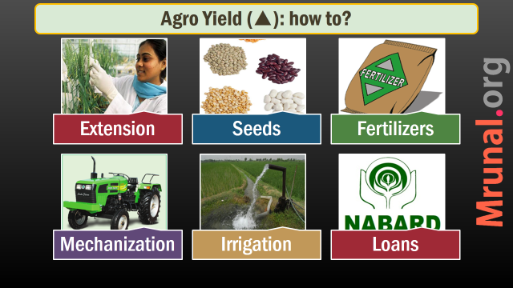
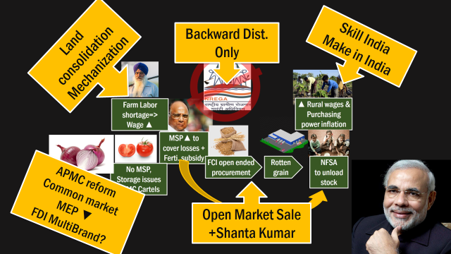
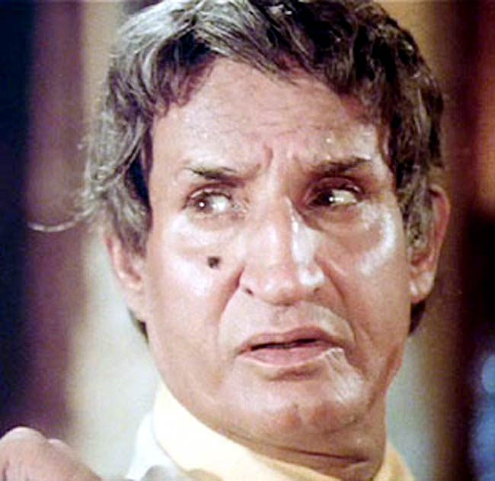
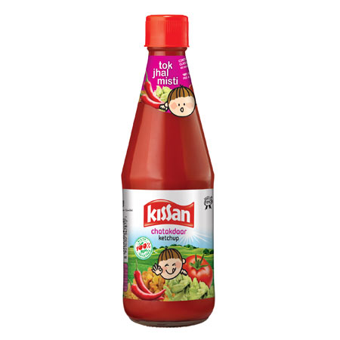

Slide 40
Post Production
Public procurement FCI-PDS reforms
Article LINK
Private Selling APMC: Reforms
Article Link
Food Processing After Prelims.
Article Link

Slide 41
Shanta Kumar FCI-PDS Reforms (Full Article link)
Procurement
6% Farmers benefit
Storage
Grains rotten and Siphoned
Distribution
Leakages Trim NFSA
Later in HRD-JAM lecture
Transport
Leakages

Slide 42
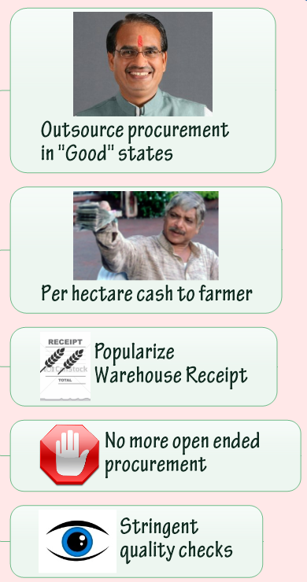
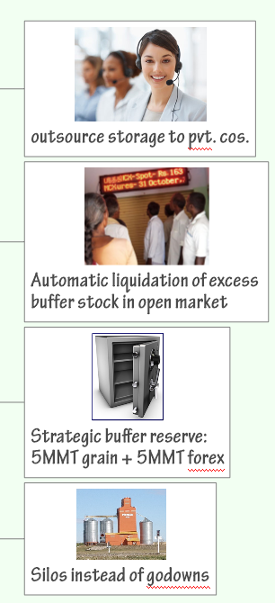
Procurement
Storage
Notes:
20 million metric tonnnes / 30 mil.

Slide 43
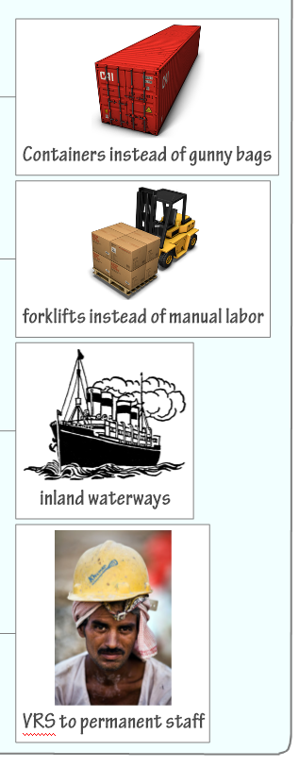
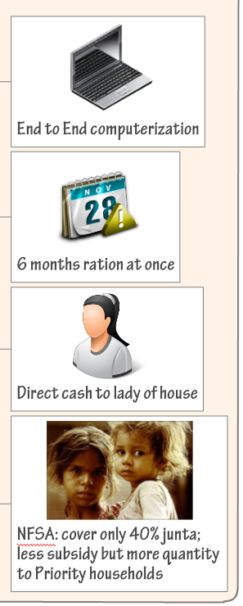

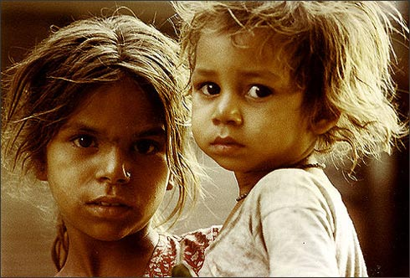
Transport
Distribution

Slide 44
Post Production
Public procurement FCI-PDS reforms
Article LINK
Private Selling APMC: Reforms
Article Link
Food Processing After Prelims.
Article Link

Slide 45
Bottlenecks
APMC
Agriculture, market, fairs: State list
State APMC Acts
~2500 agro produce market Committee / Mandi.
Farmer can make “First sell” through Mandi only
Cartel formation, double commission.
Market fees, levies, multiple taxes, cascading effect, hoarding, food inflation.

Slide 46
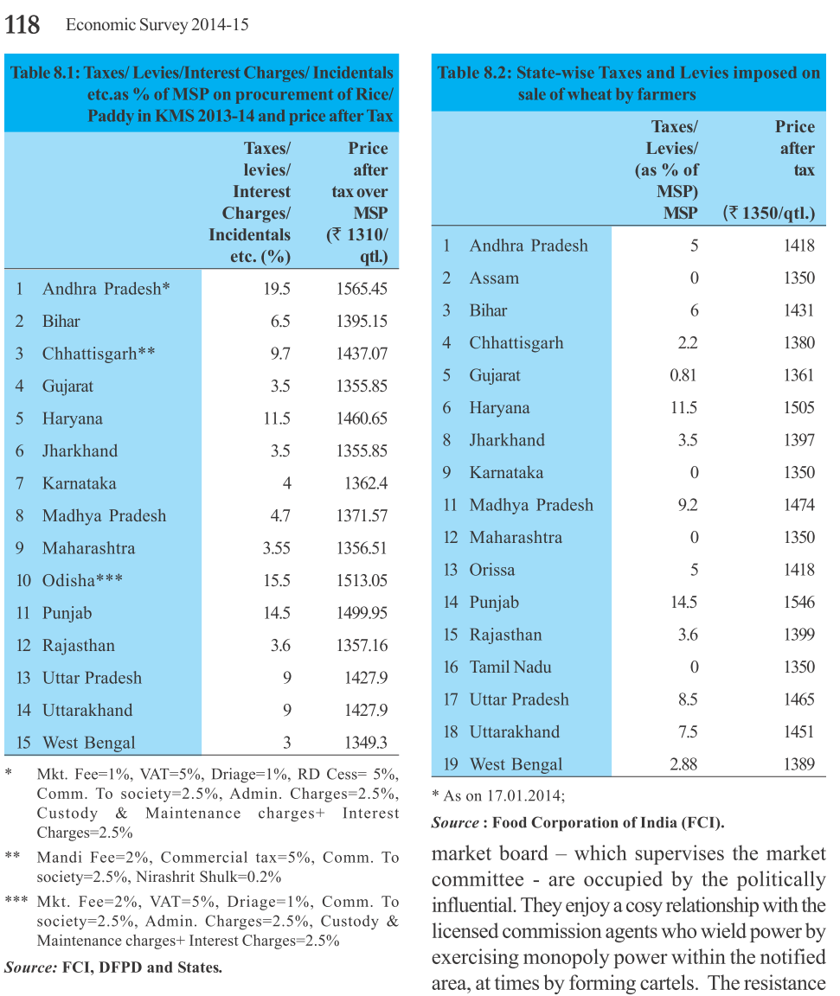
Impact of taxes on rice and wheat

Slide 47
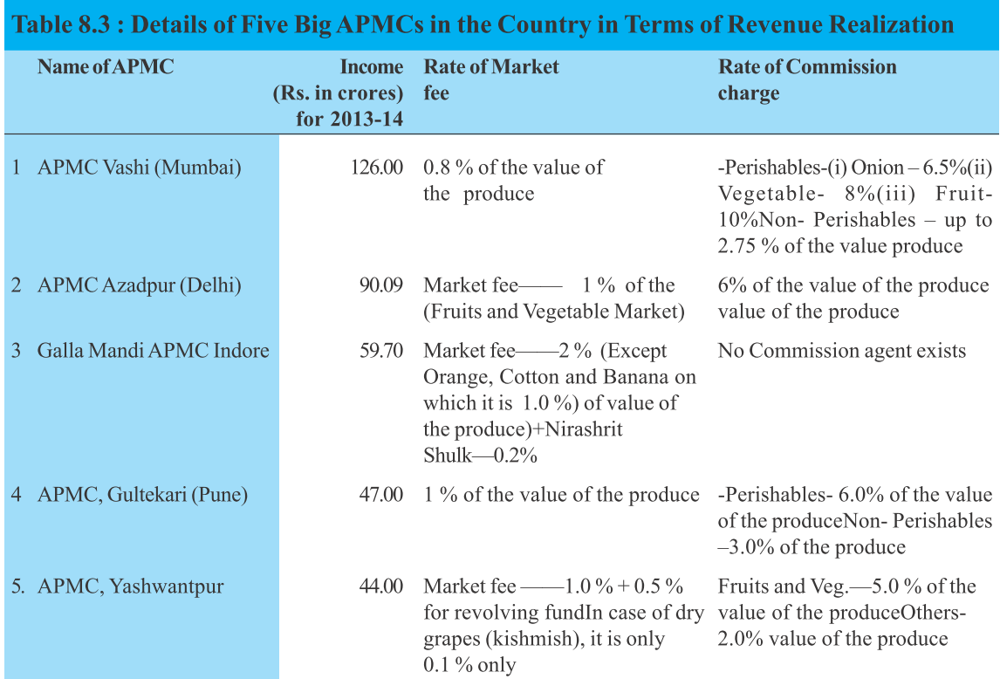
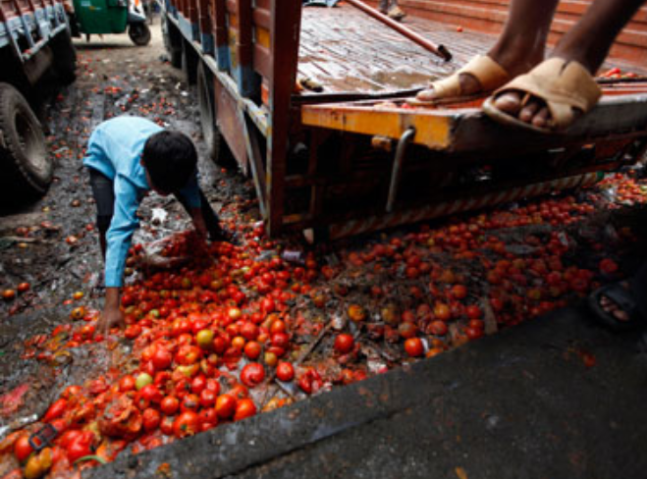
Money not used for improving market infra.

Slide 48
Problem and solution
APMC
Revenue not used for infra Development: => Rotten produce
Limited number of licenses: oligopoly, cartelization
Political patronage, resistance to change
Solution: each state should adopt the Model APMC Act by union agri. ministry

Slide 49

Model Act 2003
APMC
Facilitates Contract farming model
Special market for perishables
farmers, private persons can setup own market
Licensing norms relaxed
Only a single market fee
APMC Revenue to be used for Improving market infrastructure

Slide 50

Model Act 2003
APMC
Not all states passed the bill
Some passed but not framed rules
Tax rates vary across states
Inter-state barriers remain
Can’t create national / state level “common” market.

Slide 51

E-Platform
APMC
Declare entire state “one market one license, no movement restriction”
Then, Common national market through e-platform
Agri-Tech Infrastructure Fund (ATIF) 200 crores.
Some states exempted fruits & veggies from APMC to implement this.
Budget 2015: Create United National Agriculture Market with help of States Government and NITI ayog.

Slide 52
Can union interfere in Agro trade?
State list
Concurrent List
14.agro
26.Trade commerce within city
28.Market and fairs
33.production, trade, commerce, supply and distribution of foodstuff
42.interstate trade and commerce.
Heavy handed approach vs “Cooperative federalism”?

Slide 53
Mains Question
“Agricultural commodities markets have to be made more competitive in the interests of both producers and consumers.” Examine the legal-Constitutional impediments involved and suggest remedies. 200 words.

Slide 54
